Slide 1

Internship Project

Slide 2

Student Name : SAI KUMAR REDDY CHINTHAKUNTA
Student ID :Sai Kumar Reddy _STU66ba24b9a2bba1723475129
College Name :KRISHNA UNIVERSITY COLLEGE OF ENGINEERING TECHNOLOGY

Slide 3
CAPSTONE PROJECT SHOWCASE
Project Title : Energy Consumption Trend Analysis With Power Bi
Abstract | Problem Statement | Project Overview | Proposed Solution | Technology Used | Modelling & Results | Conclusion | Q&A

Slide 4
Abstract
A Power BI dashboard for energy consumption serves as a pivotal tool in monitoring and optimizing energy usage. It allows users to analyze historical data, track real-time consumption, and forecast future trends. The dashboard visualizes crucial metrics such as energy generation, outages, and peak usage times, facilitating informed decision-making. By providing a comprehensive view of energy patterns, it enables users to identify inefficiencies and implement corrective measures, ultimately enhancing energy management and sustainability efforts.

Slide 5
Problem Statement
Develop an interactive Power BI dashboard to analyze energy consumption data for a business, providing insights into total costs, unit consumption, and trends across different energy types (gas, electricity, water).

Slide 6
Project Overview
This project aims to develop a Power BI dashboard for energy consumption provides a holistic view of energy usage and management, leveraging modern technologies for data collection, integration, and visualization. By utilizing smart meters and IoT devices, the dashboard gathers real-time energy data, which is then analyzed using Power BI's robust analytical tools. This enables the identification of usage patterns, peak times, and inefficiencies, facilitating informed decision-making. The dashboard supports real-time monitoring, forecasting, and the implementation of optimization strategies, ultimately enhancing energy management and sustainability efforts. Through automated reporting and alerts, stakeholders remain informed, ensuring continuous improvement and cost savings in energy consumption..

Slide 7
Proposed Solution
A Power BI dashboard for energy consumption offers a comprehensive solution to address inefficiencies and high costs associated with energy use. By collecting and integrating data from various sources such as smart meters and IoT devices, the dashboard visualizes key metrics, enabling real-time monitoring and analysis. This visualization aids in identifying usage patterns, peak times, and anomalies. Furthermore, Power BI's analytical tools facilitate forecasting future energy needs and trends, empowering organizations to implement optimization strategies and cost-saving measures. Automated reports and alerts ensure stakeholders stay informed, supporting better energy management and sustainability efforts.

Slide 8
Technology Used
The Power BI dashboard for energy consumption leverages various technologies to enhance data collection, integration, and visualization. Smart meters and IoT devices play a crucial role in gathering real-time energy data. This data is then integrated into Power BI, a robust business analytics tool, allowing for seamless visualization of key metrics. Power BI's advanced analytical capabilities, including machine learning and predictive analytics, help forecast future energy needs and trends. Additionally, real-time data feeds and automated reporting features ensure continuous monitoring and timely alerts. These technologies collectively support efficient energy management and sustainability efforts.

Slide 9


Slide 10
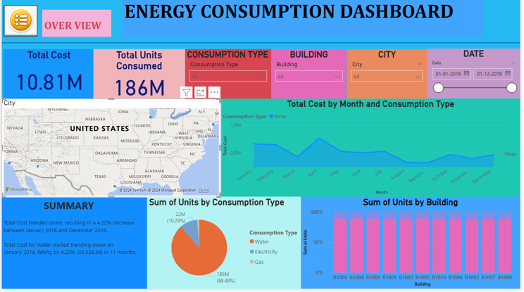
Modelling & Results

Slide 11
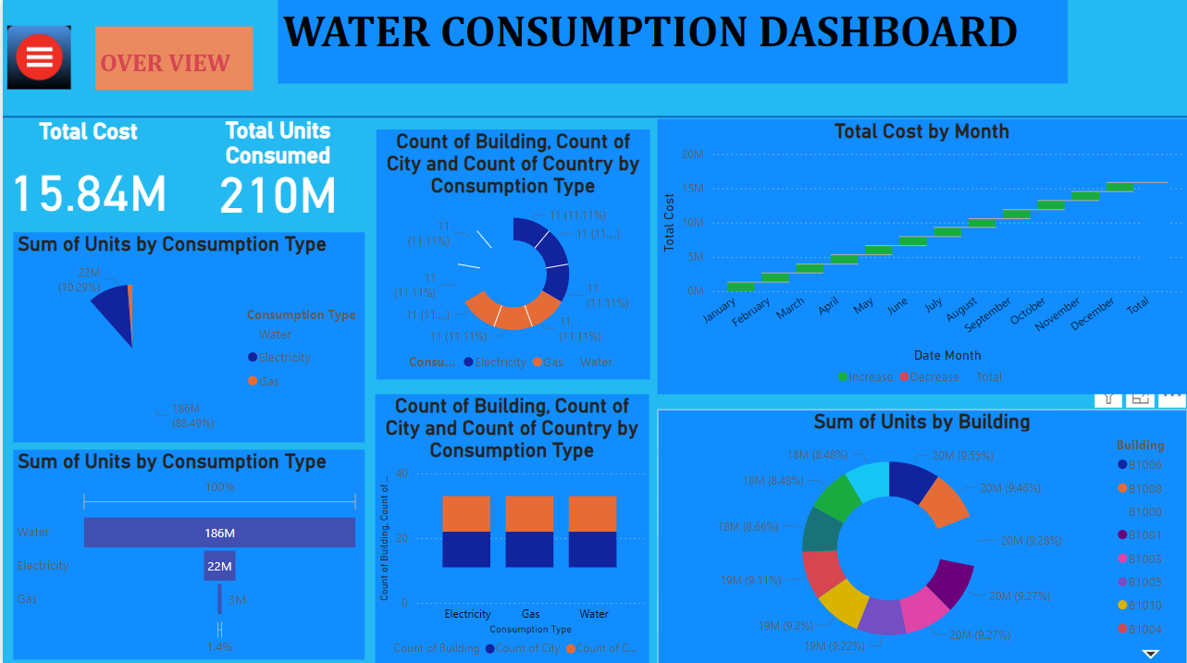
Modelling & Results

Slide 12
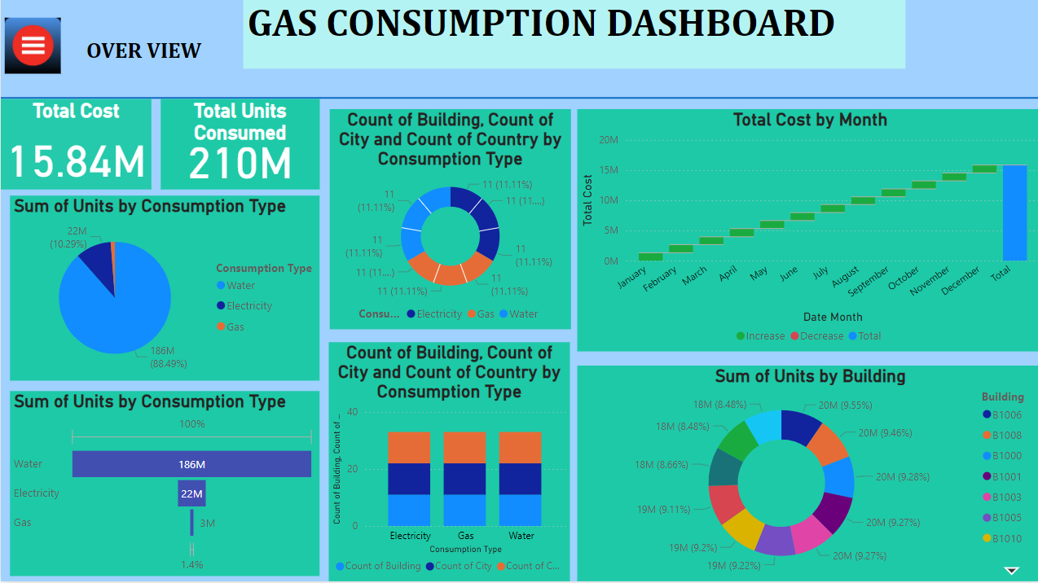
Modelling & Results

Slide 13
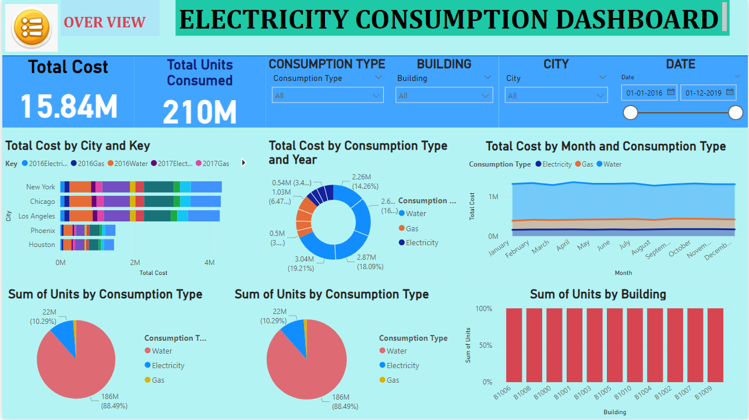
Modelling & Results

Slide 14
Conclusion
In conclusion, leveraging a Power BI dashboard for energy consumption offers a highly effective and efficient solution for managing and optimizing energy use. By integrating data from smart meters and IoT devices, and utilizing Power BI's robust analytical and visualization tools, organizations can gain comprehensive insights into energy patterns and trends. This enables real-time monitoring, forecasting, and the implementation of strategic measures to reduce costs and enhance sustainability efforts. The combination of advanced technology and detailed data analysis supports informed decision-making and fosters better overall energy management.

Slide 15

Notes:
Thank You !!

